Slide 1
NEUROENDOCRINE TUMOUR
UPDATE
MEETING SUMMARY ESMO 2019,
Barcelona, Spain
Dr.ZAHERA FAHED
CES,DIS,DISC
SYRIAN ASSOCIATION OF ONCOLOGY MEETING
DAMASCUS 5 NOVAMBER2019
PALACE

Slide 2
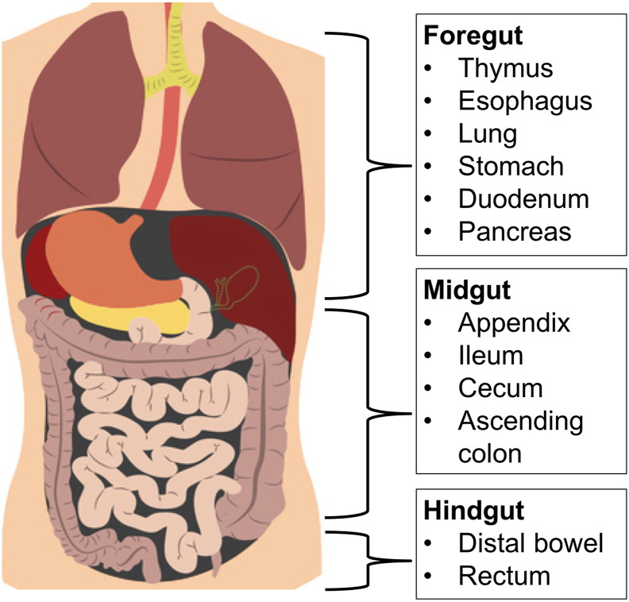
Introduction to NET
Diagnostic & therapeutic challenges
• NET are relatively rare; this is associated with limited knowledge on disease management
• The natural history of NET is poorly understood
• At least 40 different entities arising in different organs; different terminologies and classifications
Heterogeneous group of tumors
• Wide variety of clinical presentations
Late presentation Over 60% of NETs are advanced at the time of diagnosis
The median survival for patients with advanced NET is 33 months
Histologic diagnosis may be difficult
Variety of therapeutic options/approaches
Limited phase III evidence for chemotherapy and PRRT
Pancreatic NETs
• Insulinoma
• Glucagonoma
• VIPoma
• Pancreatic
polypeptidoma

Slide 3
NETs Are Second Most Prevalent Gastrointestinal Tumor

Slide 4
APPROVED THERAPEUTIC OPTIONS IN NEUROENDOCRINE TUMOURS

Slide 5
Main 3 Trials
NEUROENDOCRINE TUMOUR PRESENTATIONS
AT ESMO 2019

Slide 6
SANET-ep:
A PHASE III STUDY OF SURUFATINIB IN PATIENTS WITH WELL DIFFERENTIATED ADVANCED EXTRAPANCREATIC NET
Xu, et al. ESMO 2019 Abstract #LBA76

Slide 7
BACKGROUND
surufatinib is an anti-angiogenic TKI that selectively inhibits VEGFR, FGFR &CSF-1R
• Anti-VEGF signaling pathway is a proven strategy for treatment of pancreatic NETs but its effect in extra-pancreatic NETs has yet to be proven
• SANET-ep investigates the effect of surufatinib in patients with advanced, well differentiated extra-pancreatic NETs
CSF-1R, colony stimulating factor-1 receptor; FGFR, fibroblast growth factor receptor; NET, neuroendocrine tumour; VEGF(R), vascular endothelial growth factor (receptor) 1. Raymond E, et al. N Engl J Med 2011;364:501–13;2. Xu J, et al. Presented at ESMO 2019. Abstract #LBA76

Slide 8
SANET-epSTUDY DESIGN
PROGRESSIVE ADVANCED EXTRA-PANCREATIC NET PATIENTS
Tumour origin: A, jejunum; ileum, duodenum, thymus, cecum; B: lung, stomach, liver, appendix, colon, rectum; C: other or unknown.
Study was terminated due to superiority following a pre-planned interim analysis at 127 PFS event
DCR, disease control rate; DoR, duration of response; NET, neuroendocrine tumours; ORR, objective response rate; OS, overall survival; PD, progressive disease; PFS, progression-free survival; TTR, time to tumour response Xu J, et al.
Presented at ESMO 2019. Abstract #LBA76

Slide 9
SANET-epPRIMARY ENDPOINT RESULTS
PROGRESSION FREE SURVIVAL (INVESTIGATOR ASSESSED)
• PFS 9.2 months (surufatinib) vs 3.8 months (placebo)
CI, confidence interval; HR, hazard ratio; PFS, progression free survival Xu J, et al. Presented at ESMO 2019. Abstract #LBA76
SANET-epPRIMARY ENDPOINT RESULTS
• PFS 9.2 months (surufatinib) vs 3.8 months (placebo)

Slide 10
SUMMARY
Surufatinib significantly improved PFS in patients with advanced extra-pancreatic NETs1
• One limitation of the SANET-ep study is that it was conducted in an Asian population only
• A poster presentation at ESMO 2019 reported on the safety profile of surufatinib in solid tumours in a western population
– The safety profile in the western population was shown to be similar to that reported in the Asian population
• Further data is required in a western population before implementing in clinical practice
• However, this is a step forward in delivering new options for patients with NETs
NET, neuroendocrine tumours 1. Xu J, et al. Presented at ESMO 2019. Abstract #LBA76 ; 2. Hamilton E, et al. Presented at ESMO 2019. Abstract #1393P

Slide 11
NETTER-1 (POST HOC ANALYSIS): RELATION BETWEEN OBJECTIVE TUMOUR SHRINKAGE AND PFS
Pavel, et al. ESMO 2019 Abstract #1382PD

Slide 12
BACKGROUND
NETTER-1 investigated the effect of 177Lu-DOTATATEplus octreotide in patients with progressive midgut NETs1
• The NETTER-1 trial was instrumental in PRRT now being part of the treatment pathway for patients with NET
• Treatment efficacy has often been associated with early reduction of tumour size
• This post-hoc analysis of NETTER-1 examined whether achieving objective tumour shrinkage predicts duration of PFS
Lu, lutetium; NET, neuroendocrine tumour; PFS, progression free survival; PRRT, peptide receptor radionuclide therapy 1. StrosbergJ. NEJM 2017; 376:125-35; 2. Pavel M. ESMO 2019 Abstract #1382PD

Slide 13
NETTER-1 PHASE III TRIAL
MAIN STUDY DESIGN
Primary post hoc analysis for tumourshrinkage was based on the time interval between baseline and 150 days from baseline and conducted on the full analysis set of229 patients
GBq, gigabecquerels; LAR, long acting release; Lu, lutetium; RECIST, response evaluation criteria in solid tumors Strosberg J. NEJM 2017;376:125-35

Slide 14
NETTER-1 (POST-HOC ANALYSIS)
PFS IN RELATION TO TUMOUR RESPONSE IN THE 177Lu-DOTATATE GROUP
PFS, progression free survival Pavel, M. ESMO 2019 Abstract #1382PD

Slide 15
SUMMARY
All patients benefitted from treatment with PRRT regardless of tumour shrinkage
– Benefit of 4 cycles of PRRT treatment should not only be assessed by tumour shrinkage
PRRT, peptide receptor radionuclide therapy Pavel M. ESMO 2019 Abstract #1382PD

Slide 16
HEPAR PLUS: A PHASE 2 OPEN LABEL STUDY OF 177LU-DOTATATE PLUS 166HO-RADIOEMBOLISM IN PATIENTS WITH NETs
Braat, et al. ESMO 2019 Abstract #1380O

Slide 17
BACKGROUND
At diagnosis 21% of the patients with a grade 1 NET and 30% with a grade 2 NET have distant metastases1
• The liver is the most commonly affected organ in metastatic disease and is the most incriminating factor for patient survival1
• Treatment with peptide receptor radionuclide therapy (PRRT) shows a high objective response rate and long median survival after treatment However, complete remission is almost never achieved1,2
• Additional treatment of liver disease after PRRT may improve outcome in NET patients2
– Radioembolization is an established therapy for liver metastasis
NET, neuroendocrine tumour; PRRT, peptide receptor radionuclide therapy 1. BraatA, et al. BMC Gastroenterology 2018;18:84; BraatA, et al. ECIO 2019 Abstract #1902.3

Slide 18
HEPAR PLUS STUDY DESIGN
• Non-randomised, single arm, phase 2 study
– 34 patients included
– 31 patients treated
– 30 patients evaluable
• Primary objectives: objective response rate (RECIST 1.1) 3 months after 166Ho-RE
• Secondary endpoints: toxicity profile, biochemical response, QoL, biodistribution and dosimetry
QoL, quality of life; RE, radioembolization
BraatA, et al. BMC Gastroenterology 2018;18:84; BraatA, et al. Presented at ESMO 2019 Abstract #1380O

Slide 19
SUMMARY
HEPAR PLUS is the first trial in this setting and suggests that radioembolization after treatment with PRRT may benefit patients with NETs
• Promising results seen from HEPAR PLUS but must be confirmed in a randomisedphase 3 trial

Slide 20
